Slide 2
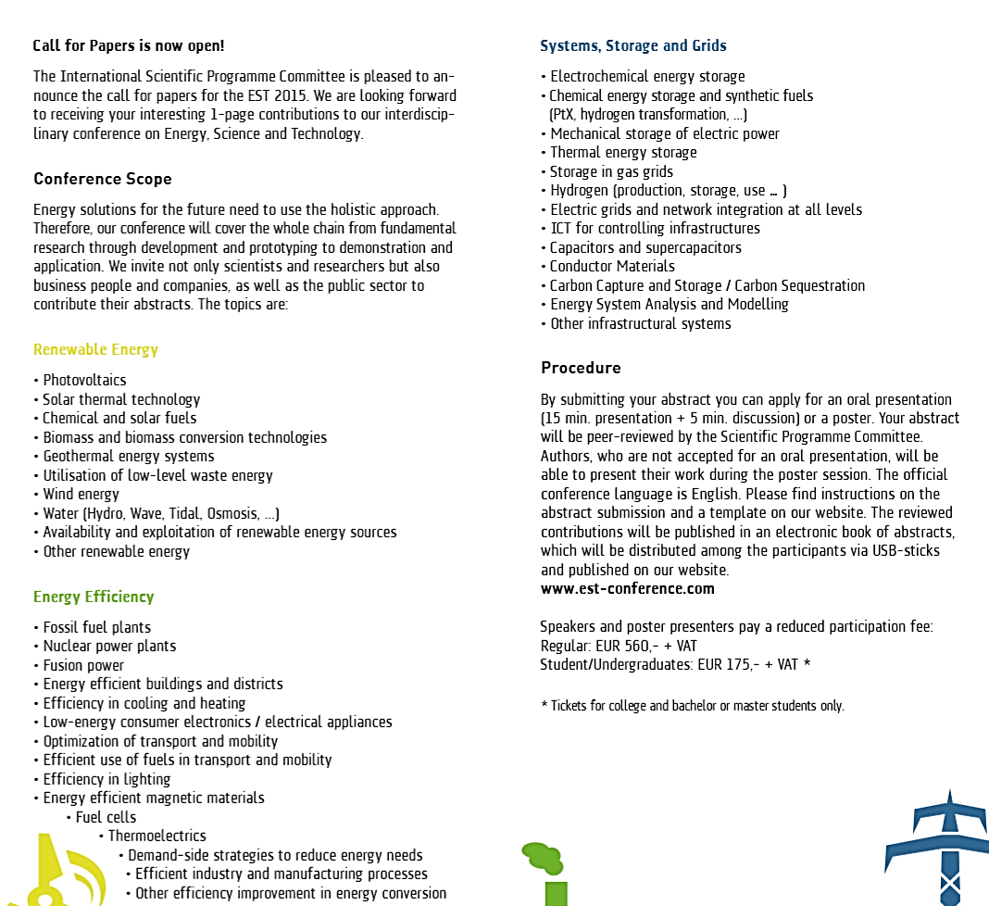

Slide 3
Critical Dates: 1.12. oral papers
31.1.15 poster papers
Major issue:
What about the E2C-series?
Is the E2C steering committee still alive?
E2C conference in 2017?
Which partnership?
Can one (who?) have a meeting of the
E2C steering committee in Karlsruhe?

Slide 4
Renewable Energy
Photovoltaics | Nicola Armaroli (Vice Chair), Research director, National Research Council (CNR), Italy
Solar thermal technology | Prof. Dr. Pitz-Paal, DLR Institute of Solar Research, Cologne, Germany
Chemical and solar fuels | Prof. Jordi Llorca, Universitat Politecnica de Catalunya, Barcelona, Spain
Biomass and biomass conversion technologies | Prof. James Dumesic, University of Wisconsin Madison, USA
Geothermal energy systems | Ladislaus Rybach, International Geothermal Association (IGA), Switzerland
Utilisation of low-level waste energy | Prof. Cheng-Liang Chen, Director of Petrochemical Research Center, National Taiwan University
Wind energy | J. Kröning, Managing Director, DEWI-OCC, Germany
Water (Hydro, Wave, Tidal, Osmosis, ...) | Klaus Krueger, Voith Hydro Holding
Availability and exploitation of renewable energy sources | Prof. Dr. Daniela Thrän, Helmholtz Centre for Environmental Research

Slide 5
Energy Efficiency
Fossil fuel plants | Prof. Dr. Hans-Jörg Bauer, Thermal Turbomachines, KIT, Karlsruhe, Germany
Nuclear power plants | Dr. Claude Degueldre, Paul Scherer Institute, Switzerland
Fusion power | Friedrich Wagner, MPI Greifswald, Germany
Energy efficient buildings and districts | Prof. Andreas Wagner, Building Science, KIT, Karlsruhe, Germany
Efficiency in cooling and heating | Prof. Ursula Eicker, Institute of Applied Research, Stuttgart, Germany
Low-energy consumer electronics / electrical appliances | see ICT
Optimization of transport and mobility | Prof. Dr. Thomas Hamacher, Technical University of Munich, Germany
Efficient use of fuels in transport and mobility | Prof. Dr. Thomas Koch, Institute for Piston Engines, KIT, Germany
Efficiency in lighting | Prof. Konstantinos Papamichael, California Lighting Technology Center, University of California, USA
Energy efficient magnetic materials | Elisabetta Agostinelli, CNR, Rome, Italy
Fuel cells | Prof. Robert Slade, Inorganic and Materials Chemistry, University of Surrey, UK
Thermoelectrics | Prof. Dr. Anke Weidenkaff, University of Stuttgart, Germany
Demand-side strategies to reduce energy needs | -
Efficient industry and manufacturing processes | Prof. Dr. Albert Albers, Institute of Product Engineering, KIT, Germany

Slide 6
Systems, Storage and Grids
Electrochemical energy storage | Prof. Kristina Edström, Uppsala University
Chemical energy storage and synthetic fuels (PtX, hydrogen transformation, ...) | Dr. Marie-Isabelle Baraton, Université de Limoges, France
Mechanical storage of electric power | Prof. Dr. Ulrich Platt, University of Heidelberg, Germany
Thermal energy storage | Dr. Antje Wörner, Engineering Thermodynamics, DLR, Germany
Storage in gas grids | Dr. Milagros Rey Porto, Renewable Energy Storage, Gas Natural, Spain
Hydrogen (production, storage, use ... ) | Jordi Llorca (see “Chemical and Solar Fuels”)
Electric grids and network integration at all levels | Dr. Brigitte Bach, Energy Department, AIT, Vienna, Austria
ICT for controlling infrastructures | Prof. Dr. Hartmut Schmeck, Institute of Applied Informatics and Formal Description Methods, KIT, Karlsruhe
Capacitors and supercapacitors | Dr. Nae-Lih Wu, National Taiwan University
Conductor Materials | Prof. Dr. Mathias Noe, Technical Physics, KIT, Karlsruhe, Germany
Carbon Capture and Storage / Carbon Sequestration | Prof. Dr. Frank Schilling, Institute of Applied Geoscience, KIT, Germany
Energy System Analysis and Modelling | Prof. Dr. Kai Sundmacher, MPI Magdeburg, Germany

Slide 8
EPS-SIF Summer school: http://www.sif.it/attivita/scuola_energia

Slide 9
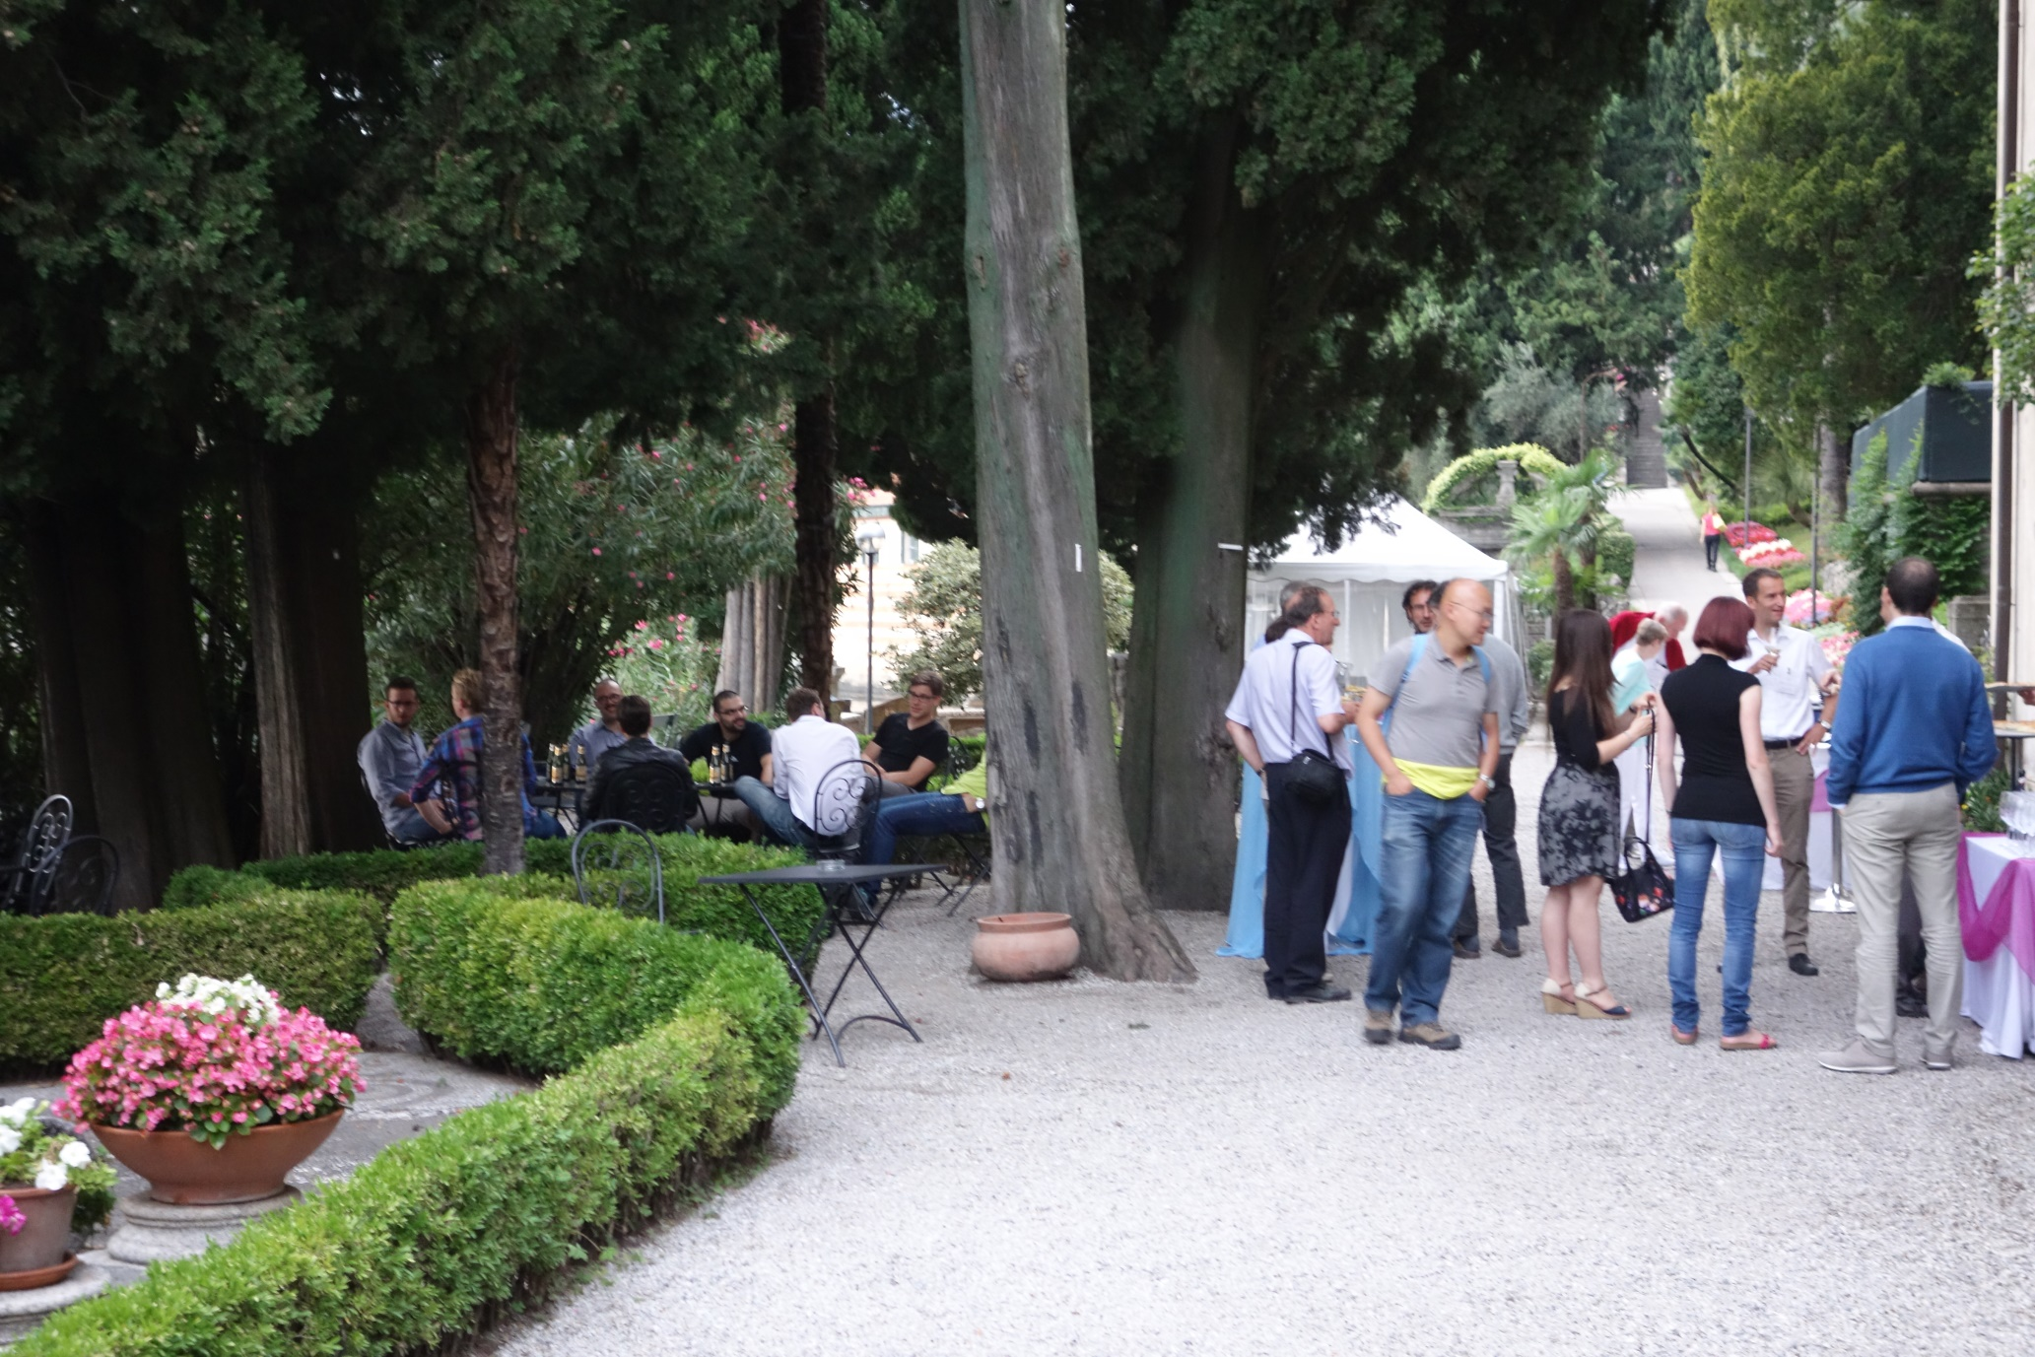

Slide 11
P
Problem: Not enough paying students
Next school (if it can be financed) 2016

